Slide 1
INTRODUCTION:
Diabetes is the common disease faced by the all types and all age group people. Due to this disease the body doesn’t produce a required amount of hormones.
The cells in our body needs glucose for growth that hormone is sort of essential. If somebody has polygenic disease, very little or no hormone is secreted. during this state of affairs, plenty of glucose is accessible within the blood stream however the body is unable to use it primarily there square measure 2 styles of polygenic disease ,which are Type-1 and Type-2.

Slide 2
INTRODUCTION
Type-1 polygenic disease happens once the body's immune system is attacked and therefore the beta cells (these cells manufacture insulin) of exocrine gland square measure destroyed. This ends up in hormone deficiency.
The only treatment to Type-1 polygenic disease is hormone. On the opposite hand,Type-2 polygenic disease is caused by relative hormone deficiency. exocrine gland inType-2 polygenic disease still produces hormone however it should not be effective or may not manufacture spare quantity of hormone to manage blood glucose . Type-2 polygenic disease is that the commonest type of polygenic disease, which usually develops at age forty and older.

Slide 3
Abstract:
Diabetes may be a one in all the leading explanation for visual defect, kidney failure, amputations, coronary failure and stroke. When we eat, our body turns food into sugars, or glucose. At that time, our exocrine gland is meant to unleash internal secretion. internal secretion is a "key” to open our cells, to permit the aldohexose to enter and permit us to utilize the aldohexose for energy.
However with diabetes, this method does not work. many major things will get it wrong – inflicting the onset of diabetes. Type 1 and type 2 diabetes are the most common forms of the disease. This paper focuses on development in machine learning that have created important impacts within the detection diabetes. Using different algorithms, we will be generating a proper output.

Slide 4
Literature Survey

Slide 5
Ref No. | Title of paper | Abstract | Outcome | Methodology | Research gap
1 | Diabetes Detection Using Machine Learning Classification Methods , 2021. | The main objective of this research is to predict the possible presence of diabetes -specifically in females- at an early stage using different machine learning techniques. | this model produced an accuracy of 82% based on the random forest classifier model. | Random Forest Classifier is one of the simplest and most diverse algorithms used for both classification and regression tasks, it uses multiple individual decision trees to operate as a single one.. | Less Accuracy Only 82% accuracy
2 | Investigating Health-Related Features and Their Impact on the Prediction of Diabetes Using Machine Learning , 2021. | To investigate the prediction of diabetic patients and compare the role of HbA1c and FPG as input features. By using five different machine learning classifiers, and using feature elimination through feature permutation and hierarchical clustering | Identified several other features like hypertension, weight, and physical activity levels that had an indirect role in diabetic prediction. The LDL/HDL tests were also found to be correlated with diabetic conditions. | Comparison of correlation before and after hierarchical clustering based on Spearman’s ranking | small-scale data

Slide 6
Ref No. | Title of paper | Abstract | Outcome | Methodology | Research gap
3 | A Decision Support System for Diabetes Prediction Using Machine Learning and Deep Learning Techniques, 2019. | employed a fully Convolutional Neural Network (CNN) to predict and detect the diabetes patients | The results showed that RF was more effective for classification of the diabetes in experiments which produced accuracy of 83.67%. The prediction accuracy for SVM reached 65.38% while DL method produced 76.81% | CNNs perform a series of operations on the input and transform it to produce the desired output. This output from previous layers can be taken as input to the next block. | No proper feature extraction and accuracy
4 | Diabetes Prediction using Machine Learning Algorithms, 2019. | Diabetes prediction model for better classification of diabetes with includes few external factors responsible for diabetes along with factors like glucose, BMI, age, Insulin, etc | Logistic Regression gives highest accuracy of 96%. Application of pipeline gave AdaBoost classifier as best model with accuracy of 98.8%. | various machine learning algorithms like Support Vector Classifier, Random Forest Classifier, Decision Tree Classifier, Extra Tree Classifier, Ada Boost algorithm, Perceptron, Logistic Regression, K-Nearest Neighbour, Gaussian Naïve Bayes, Bagging algorithm, Gradient Boost Classifier are used. | The major limitation of Logistic Regression is the assumption of linearity between the dependent variable and the independent variables. It not only provides a measure of how appropriate a predictor(coefficient size)is, but also its direction of association (positive or negative)

Slide 7
Ref No. | Title of paper | Abstract | Outcome | Methodology | Research gap
5 | ANALYSIS AND PREDICTION OF DIABETES USING MACHINELEARNING, 2019. | To determine new patterns and then to interpret these patterns to deliver significant and useful information for the users. | In this study the proposed method provides high accuracy with accuracy value of 90.36% and decision Stump provided less accuracy than other by providing 83.72% accuracy. | we have employed different classifiers like Decision Trees, KNN and Naïve Bayes. | in this study only limited base classifier used
6 | Analysis and Prediction of Diabetes Mellitus using Machine Learning Algorithm , 2018. | To cluster and predict symptoms in medical data, various data mining techniques were used by different researchers in different time | In this study the proposed method provide high accuracy with accuracy value of 90.36% and decision Stump provided less accuracy than other by providing 83.72% accuracy. | In the proposed system most known predictive algorithms applied are SVM, Naïve Net,DecisionStump, and Proposed Ensemble method (PEM) | on this study also only a single data set used in this study only limited base classifier used

Slide 8
Ref No. | Title of paper | Abstract | Outcome | Methodology | Research gap
7 | Important Feature Selection & Accuracy Comparisons of Different Machine Learning Models for Early Diabetes Detection, 2018. | introduce an approach to automatically predict type 2 diabetes mellitus (T2DM) applying a neural network. The objective of this paper is to find which type of model that works best for predicting diabetes | Result of input these features to the MLP neural network classifier which achieved an accuracy of 85.15%. | A multilayer perceptron (MLP) is a class of feed-forward artificial neural network. We use this algorithm because MLPs are used in research for their ability to solve problems sarcastically, which often allows approximate solutions for extremely complex issues like fitness approximation. | The quantity of the data-set is not large enough to train appropriately and prediction with lower efficiency
8 | Prediction of Diabetes Using Machine Learning Algorithms in Healthcare , 2018. | Comparison of the different machine learning techniques used. This study reveals which algorithm is best suited for prediction of diabetes. Helps doctors in early prediction of diabetes using machine learning techniques | In this experiment, it can be seen that SVM and KNN gives highest accuracy for predicting diabetes. Both these algorithms provide 77% accuracy which is highest as compared to other algorithms used in this paper. | six machine learning algorithms are used to predict diabetes disease. These six algorithms are K Nearest Neighbours (KNN), Naive Bayes (NB), Support Vector Machine (SVM), Decision Tree (DT), Logistic Regression (LR) and Random Forest (RF). | Some limitations of this study are the size of dataset and missing attribute values.

Slide 9
Outcome of Literature Survey:
Based on previous works from last 4 years, we have identified :
Diabetes complications caused by several types
Type 1 and Type 2 identification using administrative data
Diabetes and its subtypes' misclassification are uncertain.

Slide 10
Research Objectives:
To Train the machine learning methods for prediction of multi type diabetes diseases.
To find the performance metrics of Algorithm.
Recognizing the failures of earlier attempts to diagnose subtypes of diabetes mellitus using machine learning techniques.
Creating a model or tool for sub-types of Diabetes Mellitus diagnosis that aids in detecting the disease early in individuals and may lower the risk of developing it.

Slide 11
General Block Diagram
Importing Modules and Loading the dataset
Analyze and visualize the dataset
Model Training
Testing the Model
Model Evaluation

Slide 12
Software and Modules :
Text Editor: Google Colaboratory
Programming Language: Python
Modules:
NumPy
Pandas
Scikit-learn
Matplotlib
Seaborn

Slide 13
METHODOLOGY

Slide 14
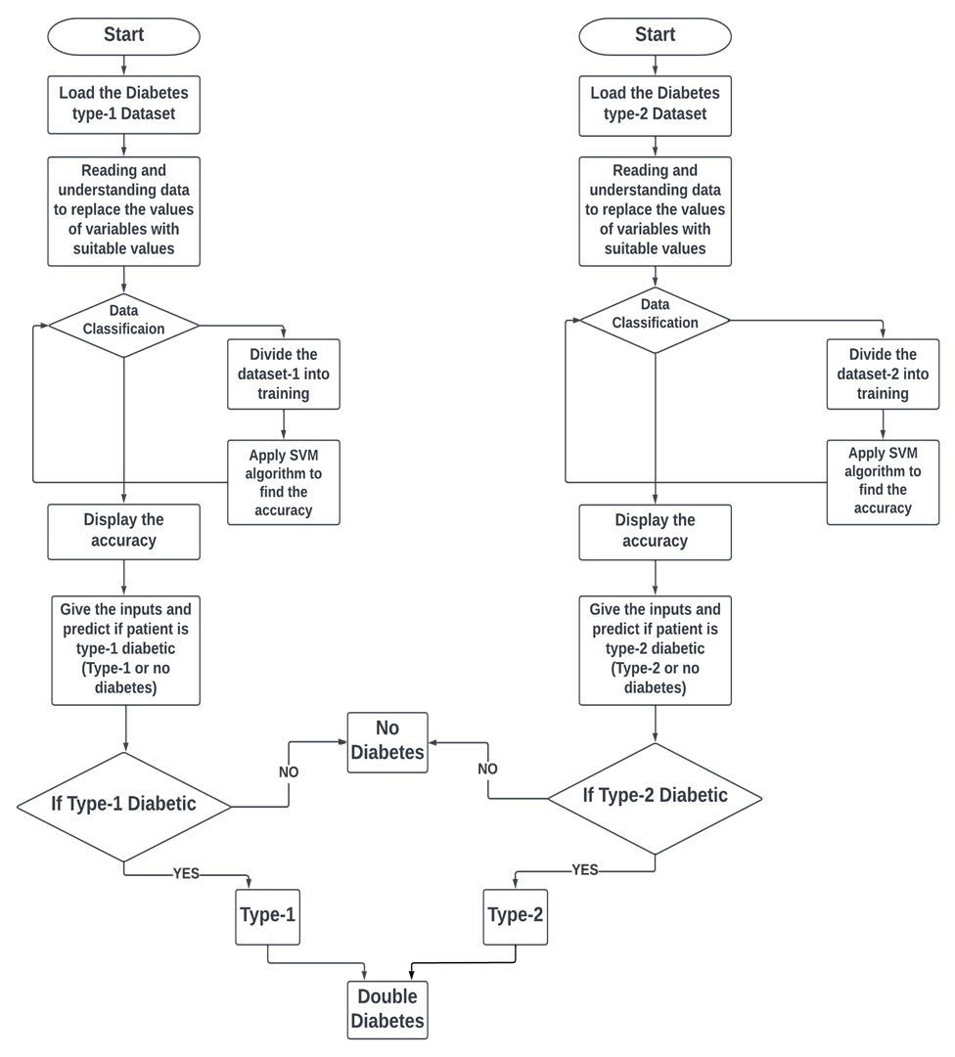

Slide 15
Support Vector Machine:
“Support Vector Machine” (SVM) is a supervised machine learning algorithm that can be used for both classification
They have two main advantages: higher speed and better performance with a limited number of samples (in the thousands).
Finds the linear hyper-plane that separates classes with the maximum margin.
Lets understand SVM with different scenarios.

Slide 16
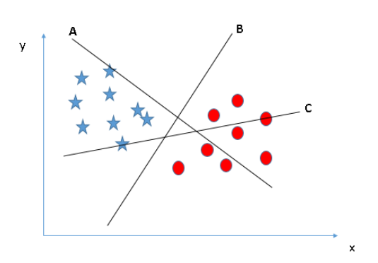
Identifying the right hyper-plane:
Scenario-1:
Result:
Hyper-plane B
Reason: Select the hyper-plane which segregates the two classes better

Slide 17
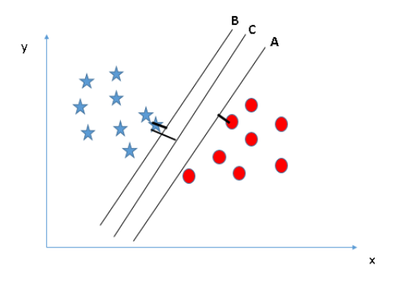
Identifying the right hyper-plane:
Scenario-2:
Result:
Hyper-plane C
Reason: The margin for hyper-plane C is high as compared to both A and B

Slide 18
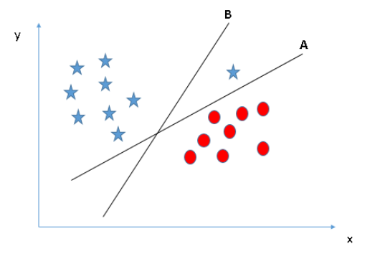
Identifying the right hyper-plane:
Scenario-3:
Result:
Hyper-plane A
Reason: SVM selects the hyper-plane which classifies the classes accurately prior to maximizing margin.

Slide 19
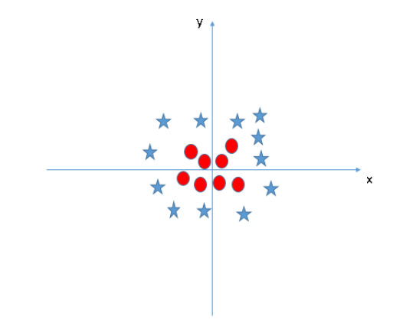
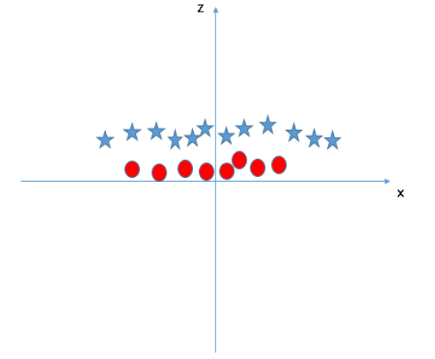
Scenario-4
Result:
Formula : Z= X^2+Y^2

Slide 20
ANALYSIS

Slide 21
Features of Dataset-1
Age
Sex
Height
Weight
BMI
Adequate Nutrition
Adequate Nutrition 1
Autoantibodies
Impaired Glucose Metabolism
Insulin Taken
How taken
Family History of Type 1 Diabetes
Family History of Type 2 Diabetes
Hypoglycemia
Pancreatic Disease affect

Slide 22
Features of Dataset-2
Age
Gender
Family Diabetes
High BP
Physical Activeness
BMI
Smoking Habit
Alcohol Habit
Proper Sleep
Sound Sleep
Regular Medicine
Junk Food
Stress
BP Level
Pregnancies
Pdiabetes
Urination Frequency

Slide 23
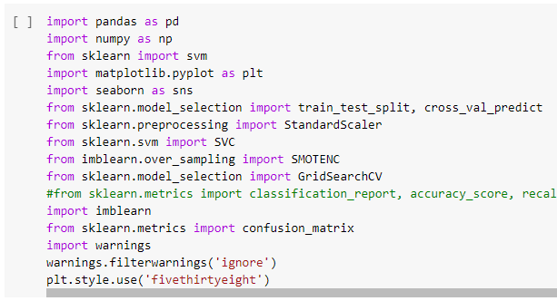
Step-1: Importing Modules and Loading the Dataset

Slide 24
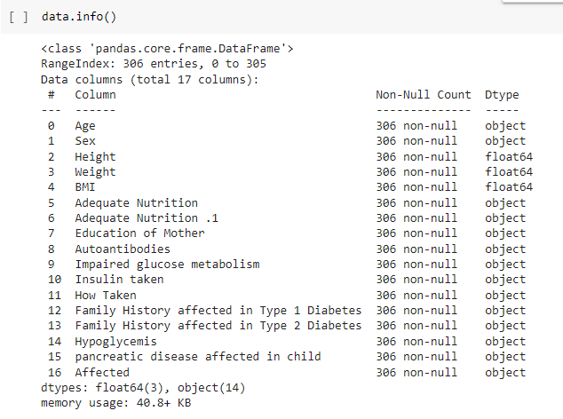
Step-2: Understanding the Dataset-1 (Analyzing)

Slide 25
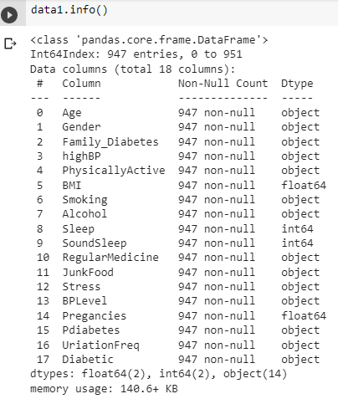
Step-2: Understanding the Dataset-2 (Analyzing)

Slide 26
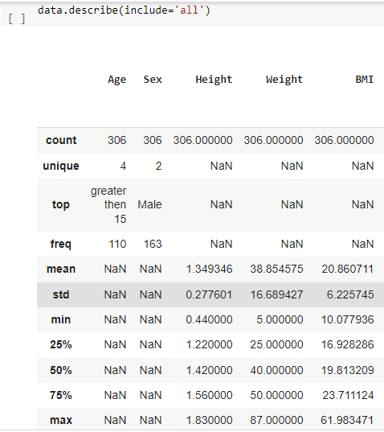
Step-2: Understanding the Data (Analyzing)

Slide 27
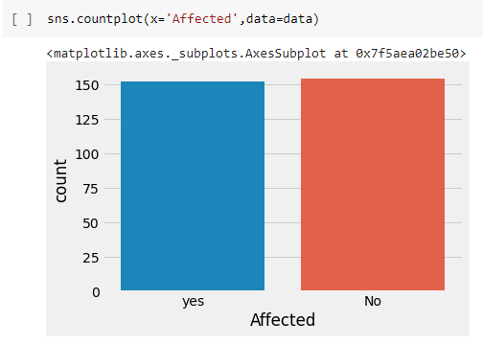
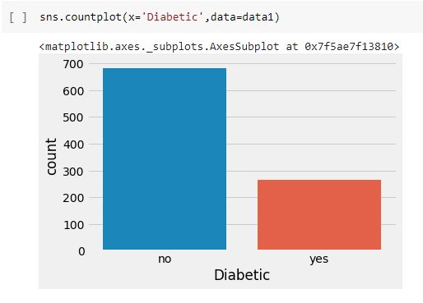
Step-2: Understanding the Data (Visualize)
Dataset-1
Dataset-2

Slide 28
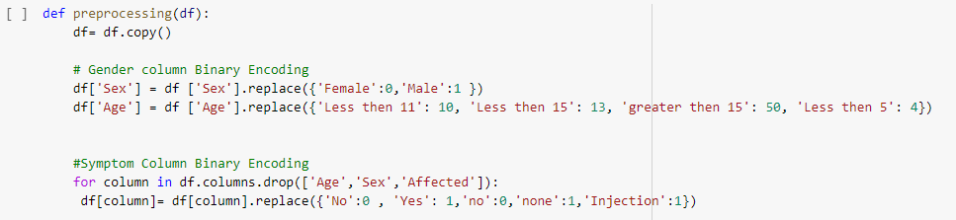
Step-2: Understanding the Data (Replacing the values of Variables - Dataset-1 )

Slide 29
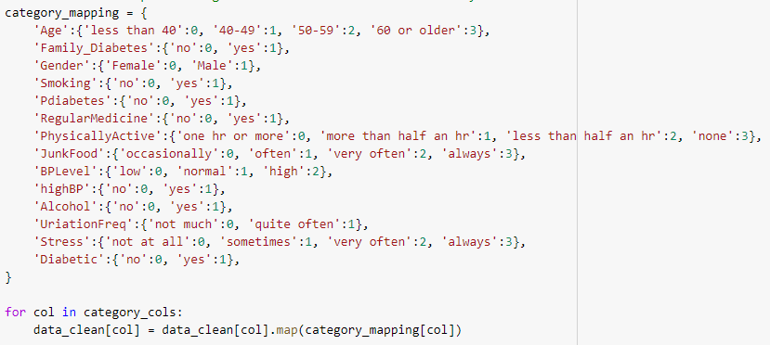
Step-2: Understanding the Data (Replacing the values of Variables - Dataset-2 )

Slide 30
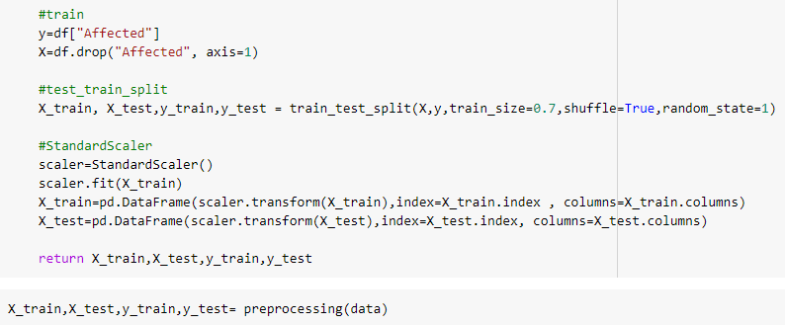
Step-3: Splitting the dataset-1 to Train and Test

Slide 31
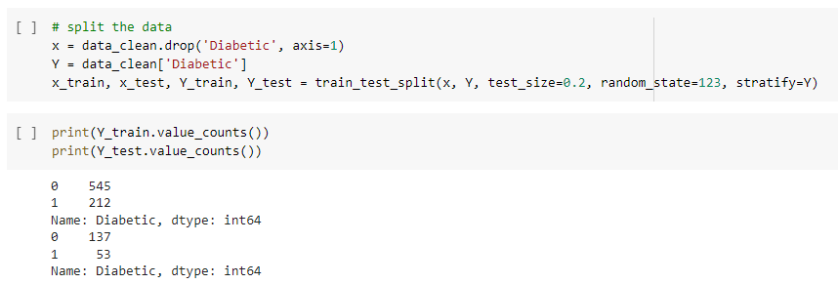
Step-3: Splitting the dataset-2 to Train and Test

Slide 32
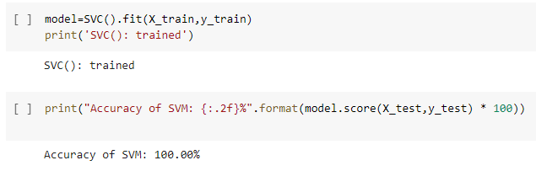
Step-4: Applying Algorithm and Displaying the accuracy
Dataset-1

Slide 33
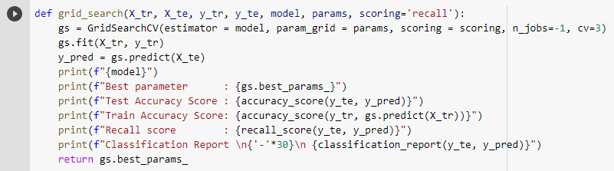
Step-4: Applying Algorithm and Displaying the accuracy
Dataset-2

Slide 34
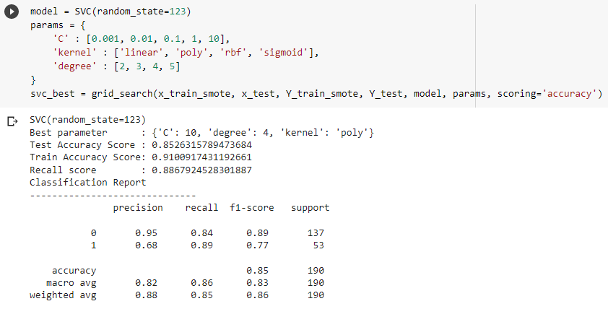
Step-4: Applying Algorithm and Displaying the accuracy
Dataset-2

Slide 35
RESULTS

Slide 36
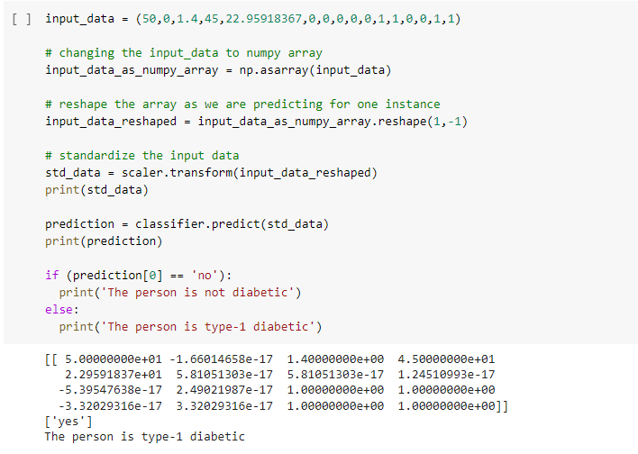
Step-5: Prediction of Type-1 Diabetes

Slide 37
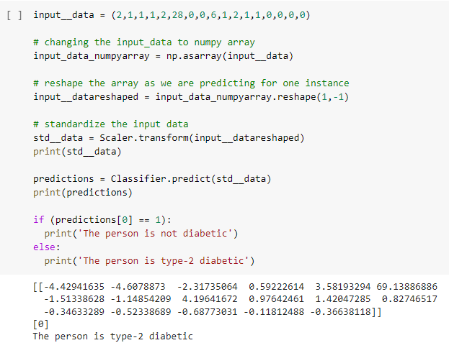
Step-5: Prediction of Type-2 Diabetes

Slide 38
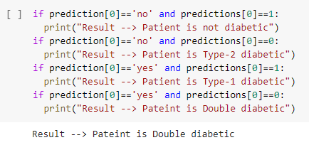
Step-6: Conclusion (Type-1 or Type-2)

Slide 39
Applications:
Early prediction of diabetes.
Correctly identify Diabetes subtypes.

Slide 40
Conclusion and Future Scope:
Hence, we are able to predict the type of diabetes. By applying SVM algorithm for the both type-1 data set and type-2 data set; the accuracy of the SVM are 100%, 85%.
SVM classifier can be optimized by tuning other parameters thus it can be beneficial to improve results. SVM classifier can be employed into any medical research for better outcomes.
We will be trying different algorithms like KNN and ANN to improve the performance.

Slide 41
References:
[1]Abdulhadi, N., & Al-Mousa, A. (2021, July). Diabetes detection using machine learning classification methods. In 2021 International Conference on Information Technology (ICIT) (pp. 350-354). IEEE.
[2]Ahmad, H. F., Mukhtar, H., Alaqail, H., Seliaman, M., & Alhumam, A. (2021). Investigating health-related features and their impact on the prediction of diabetes using machine learning. Applied Sciences, 11(3), 1173..
[3]Yahyaoui, A., Jamil, A., Rasheed, J., & Yesiltepe, M. (2019, November). A decision support system for diabetes prediction using machine learning and deep learning techniques. In 2019 1st International Informatics and Software Engineering Conference (UBMYK) (pp. 1-4). IEEE.
[4]Mujumdar, A., & Vaidehi, V. (2019). Diabetes prediction using machine learning algorithms. Procedia Computer Science, 165, 292-299.
[5]Saru, S., & Subashree, S. (2019). Analysis and prediction of diabetes using machine learning. International journal of emerging technology and innovative engineering, 5(4)

Slide 42
References:
[6]Alehegn, M., Joshi, R., & Mulay, P. (2018). Analysis and prediction of diabetes mellitus using machine learning algorithm. International Journal of Pure and Applied Mathematics, 118(9), 871-878.
[7]Rubaiat, S. Y., Rahman, M. M., & Hasan, M. K. (2018, December). Important feature selection & accuracy comparisons of different machine learning models for early diabetes detection. In 2018 International Conference on Innovation in Engineering and Technology (ICIET) (pp. 1-6). IEEE.
[8]Sarwar, M. A., Kamal, N., Hamid, W., & Shah, M. A. (2018, September). Prediction of diabetes using machine learning algorithms in healthcare. In 2018 24th international conference on automation and computing (ICAC) (pp. 1-6). IEEE.

Slide 43
Thank You!

